Slide 1

New Volunteer Orientation
Magdalena Salazar-Palma
Region 8 Past Director 2021-2022
salazar@tsc.uc3m.es
Antonio Luque
Region 8 Director 2021-2022
aluque@ieee.org
Vincenzo Piuri
Region 8 Delegate-Elect/Director-Elect 2021-2022
vincenzo.piuri@unimi.it

Slide 2
Outline
Welcome and Introduction of Participants
Overview of IEEE
Overview of Region 8
Running a Section Successfully
Overview of Member and Geographic Activities and MGA Board
Region 8 Committee Meetings
Concluding Remarks and Q&A

Slide 3
Welcome and Introduction of Participants

Slide 4
Overview of the IEEE
IEEE: The Force Behind Innovation

Slide 5
What is IEEE?
IEEE is the world's largest technical professional organization dedicated to advancing technology for the benefit of humanity.
IEEE and its members inspire a global community through IEEE's highly cited publications, conferences, technology standards, and professional and educational activities.
Key values are technical innovation, access to cutting-edge information, networking opportunities, and exclusive member benefits.

Slide 6

Our Mission
Foster technological innovation and excellence
for the benefit of humanity

Slide 7
Our Vision
Be essential to the global technical community and to technical professionals everywhere,
and be universally recognized
for the contributions of technology and
of technical professionals
in improving global conditions

Slide 8
What does IEEE and its members?
Support the mission to advance technology for humanity and the profession
Contribute to dissemination of technical knowledge
Build technical communities and network with each other
Introduce technology careers to students
Support continued/life-long education of professionals
Mentor students and professionals in career development
Promote technology awareness and professional ethics among the general public

Slide 9
Benefits of membership
Trusted voice
Global community
Profession:
  Keeping technically current
  Career resources and recognition
  Professional networking
  Continuing education
Member discounts

Slide 10
Benefits of membership
IEEE membership benefits include:
  IEEE Spectrum magazine subscription
  Collabratec member exclusive access
  IEEE ResumeLab
  IEEE Mentoring Connection
  Networking – professional & personal
  Center for Leadership Excellence https://ieee-elearning.org/CLE
  IEEE Xplore Digital Library discounts
  Conferences and discounts
  Educational opportunities

Slide 11
Member grades
Student: At least 50% of a normal full-time academic program as a registered undergraduate or graduate student in a regular course of study in IEEE-designated fields.
Graduate student: At least 50% of a normal full-time academic program as a registered graduate student in a regular course of study in IEEE-designated fields.
The total cumulative period for a member to hold the Student member grade and/or the Graduate Student member grade is limited to eight years.
Student members or Graduate Student members, upon graduation or upon reaching the total cumulative eight-year limit as a Graduate Student member (whichever occurs first), will be transferred automatically to member grade.

Slide 12
Member grades
Associate: Technical and non-technical individuals who do not meet the qualifications for member grade but who wish to benefit from membership and partnership in IEEE, and for those who are progressing, through continuing education and work experience, toward qualifications for member grade.
Student members outside of the IEEE-designated fields, upon graduation or upon reaching the eight-year limit (whichever occurs first), will be transferred to Associate member grade.

Slide 13
Member grades
Member: Those who have satisfied IEEE-specified educational requirements and/or who have demonstrated professional competence in IEEE-designated fields of interest.
For admission or transfer to the grade of member, a candidate may be either:
  An individual who has received a three- to five-year university-level or higher degree from an accredited institution or program and in an IEEE-designated field,
  An individual who has received a three- to five-year university-level or higher degree from an accredited institution or program and who has at least three years of professional work experience engaged in teaching, creating, developing, practicing, or managing in IEEE-designated field,
  An individual who, through at least six years of professional work experience, has demonstrated competence in teaching, creating, developing, practicing, or managing within IEEE-designated fields.

Slide 14
Member grades
Senior Member: Highest grade for which application may be made. Requires experience reflecting professional maturity. A candidate shall be an engineer, scientist, educator, technical executive, or originator in IEEE-designated fields and shall have been in professional practice for at least ten years and shown significant performance over a period of at least five of those years, such performance including one or more of the following:
  Substantial responsibility or achievement in IEEE-designated fields,
  Publication of papers, books, or inventions in IEEE-designated fields,
  Technical direction or management of important work with evidence of accomplishment in IEEE-designated fields,
  Recognized contributions to the welfare of the professions encompassed by IEEE-designated fields,
  Development or furtherance of important courses in one or more of the IEEE-designated fields at an institution in the REP list,
  Contributions equivalent to those of the above areas related to IEEE-designated fields, provided these contributions serve to advance progress substantially in IEEE-designated fields.

Slide 15
Member grades
Fellow: Recognizes unusual distinction in the profession and is conferred only by invitation of the Board of Directors upon a person with an extraordinary record of accomplishments in any of IEEE’s designated fields of interest.
  The candidate shall hold Senior member grade at the time the nomination is submitted.
  Normally, the candidate shall have been a member in any grade for a period of five years or more preceding 1 January of the year of elevation; however, the five-year membership requirement may be waived for a Fellow candidate who has been engaged in professional practice (as needed to qualify for Senior member grade) in a geographical area where, in the judgment of the Board of Directors, it was difficult to become a member previously, as evidenced by the absence of a Section previously and the recent formation of a new Section to cover that geographical area. In such case, membership of five years or more in a recognized local electrical, electronics, or computer-engineering society may substitute for the five-year IEEE membership requirement, when the nomination is submitted within four years after the formation of the new Section.

Slide 16
Other categories
Life member: Member who has reached the age of 65 years and who has been a member of IEEE (or one of its predecessor societies) for such a period that the sum of his/her age and his/her years of membership equals or exceeds 100 years.
  Basic dues and assessments are waived for those achieving Life Member status.
Young Professionals: Post-Student members who are within 15 years of receiving their first professional degree with an option to participate beyond the 15-year time span.
Society Affiliate: Member of an IEEE Society who are not IEEE members and are not entitled to any IEEE benefits or services that are reserved solely for IEEE members.
  All affiliate benefits and services come directly from the individual IEEE Society offering affiliation.
  For each Society one is affiliated with, the applicant pays a separate annual affiliate fee plus that IEEE Society's annual membership dues.
  Not all Societies offer affiliation.

Slide 17
IEEE quick facts (1)
More than 407,000 members in 160 countries;
39.8 % live in the United States (R1-R6), 60.1 % in R7-R10.
More than 116,000 student members.
342 Sections in 10 geographic Regions worldwide.
2,562 Chapters unite local members with similar technical interests.
3,485 Student Branches at colleges and universities in 100 countries.
2,877 Student Branch Chapters of IEEE Technical Societies.
Notes:
Updated from http://www.ieee.org/about/today/index.html 2015-03-28

Slide 18
IEEE quick facts (2)
580 Affinity Groups, non-technical sub-units:
Young Professionals (YP), Women in Engineering (WIE), Life Members (LM), IEEE-USA Consultants’ Network.
39 Societies and 7 technical Councils representing the wide range of IEEE technical interests.
More than 5 million documents in
IEEE Xplore Digital Library,
  more than 15 million downloads each month.
More than 1,200 standards and more than 900 standards under development.
Notes:
Updated from http://www.ieee.org/about/today/index.html 2015-03-28

Slide 19
IEEE quick facts (3)
More than 200 transactions, journals and magazines (1/3 of the world’s technical literature in electrical engineering, computer science and electronics):
  17 of the 20 top-cited publications in electrical and electronics engineering
  75% of the authors are from outside USA
More than 1,800 conferences in 95 countries:
  partnering with 1,300 non-IEEE entities globally
  attracting more than 485,000 conference attendees
  publishing over 1,500 conference proceedings via IEEE Explore
  Data current as of 14-03-2021, taken from https://www.ieee.org/about/at-a-glance.html
Notes:
Updated from http://www.ieee.org/about/today/index.html 2015-03-28

Slide 20
IEEE organization
Grouped into geographic areas reflecting where members live and work …
  10 Geographic Regions,
  342 Sections within Regions,
  3,485 Student Branches at colleges and universities over 100 countries.
… and technical areas based on members technical fields of interest (Knowledge Communities, both global and local):
  39 Technical Societies, 7 Technical Councils, and 12 general technical communities,
  2,562 Chapters that unite local members with similar technical interests,
  2,877 Student Branch chapters of Technical Societies.

Slide 21
IEEE organization
Members may also group up attending to non-technical interests or affinities.
The following have been approved as parent organizational units of local affinity groups:
  Consultants Network , CN,
  Life Members , LM,
  Women in Engineering , WIE,
  Young Professionals , YP (formerly GOLD).
  With a total of 486 affinity groups worldwide which are non-technical subunits of one or more Sections or Regional Councils.
Other groups are:
  IEEE Entrepreneurship ( http://entrepreneurship.ieee.org/ ),
  Special Interest Group on Humanitarian Technology (https://www.ieee.org/special_interest_group_on_humanitarian_technology.html ) and other groups focusing on humanitarian efforts,
  And several virtual communities.

Slide 22
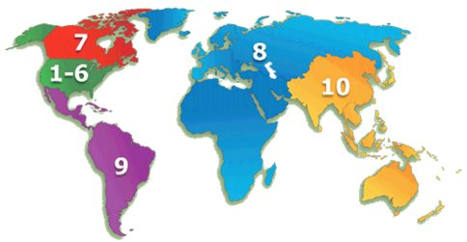
IEEE Regions

Slide 23
IEEE Divisions
39 Societies and 7 Technical Councils grouped
in 10 Divisions (same number as for Regions):
Circuits and Devices (CAS, ED, SSC; CEDA, Nano)
Industrial Applications (CPMT, DEI, IA, IM, PEL, UFFC)
Communications Technology (Com)
Electromagnetics and Radiation (AP, BT, CE, EMC, Mag, MTT, NPS; CRFID, CSC)
Computer (C)
Engineering and Human Society (E, IE, PSE, PC, R, SIT, TEM)
Energy and Power Engineering (PE)
Computer (C)
Signals and Applications (AES, GRS, IT, ITS, OE, SP, VT)
Systems and Control (CIS, CS, EMB, Pho, RA, SMC; Bio, Sen, Sys)

Slide 24
IEEE organization
Brings together members with similar interests.
Sponsors
  Conferences,
  Workshops,
  Tutorials,
  Seminars,
  And so on.
Develops publications:
  Journals,
  Magazines,
  Newsletters.
Recognizes member accomplishments.
Helps members to network through Societies, Chapters, Conferences, and other tools, e.g., IEEE CollabratecTM collabratec

Slide 25
IEEE Section – the basic GeoUnit
Sections provide a local community of colleagues.
Members build a network through activity in
  Sections,
  Chapters within the Section,
  Student Branches within the Section.
Volunteers develop new skills and experience:
  Management,
  Teamwork,
  Leadership.
Volunteers:
  Gain recognition,
  Recognize achievements of others.

Slide 26
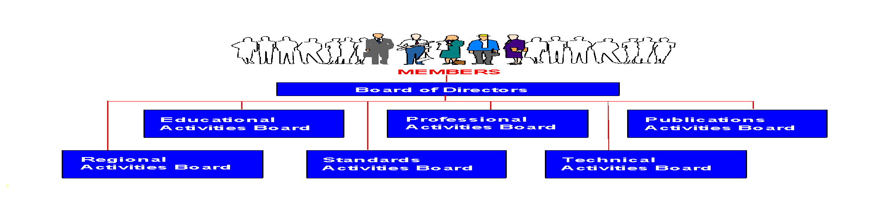
IEEE governance organization
MEMBERS
Assembly
Board of Directors
Publications, Services and Products Board
Educational Activities Board
Member & Geo Activities Board
Technical Activities Board
Standards Association
Regions & Sections
Societies &
Tech. Councils
IEEE-USA
Chapters
Notes:
PSPB= Publication Services and Products Boar

Slide 27
IEEE organization
IEEE Officers
  Voting members of IEEE elects a President each year.
  Serves for three years:
    President-Elect,
    President and CEO,
    Past-President.
President also serve on IEEE governing bodies:
  IEEE Board of Directors (31 voting members: 3 “Presidents” + 6 Vice Presidents + Secretary + Treasurer + 10 Regional Directors + 10 Division Directors),
  IEEE Assembly (23 voting members: 3 P + 10 RD + 10 DD).

Slide 28
IEEE organization
IEEE Major Boards have elected volunteer leadership.
Six subordinate boards govern major areas of IEEE interest:
  Member and Geographic Activities (MGAB),
  Technical Activities (TAB),
  Educational Activities (EAB),
  Publication Services and Products Board (PSPB),
  Standards,
  IEEE-USA.
There are a number of Committees that report either to BoD or to the Boards.
IEEE is governed by volunteers for volunteers, with the help of a reduced number of qualified staff members.

Slide 29
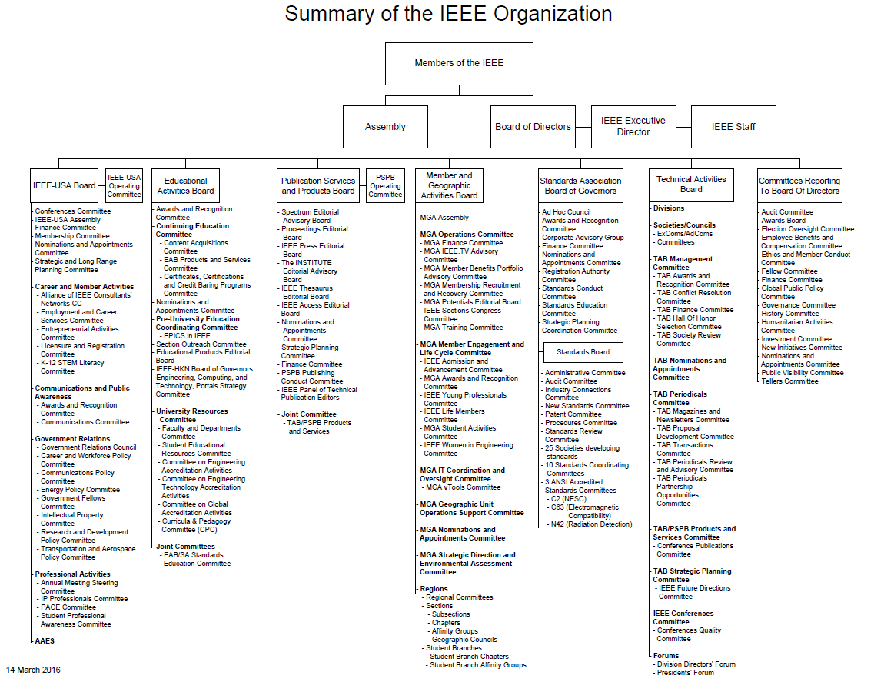

Slide 30
Overview of Region 8

Slide 31
Region 8 covers
Europe, Middle East, and Africa
Largest Region in terms of geographical extension.
Extremely high diversity.

Slide 32
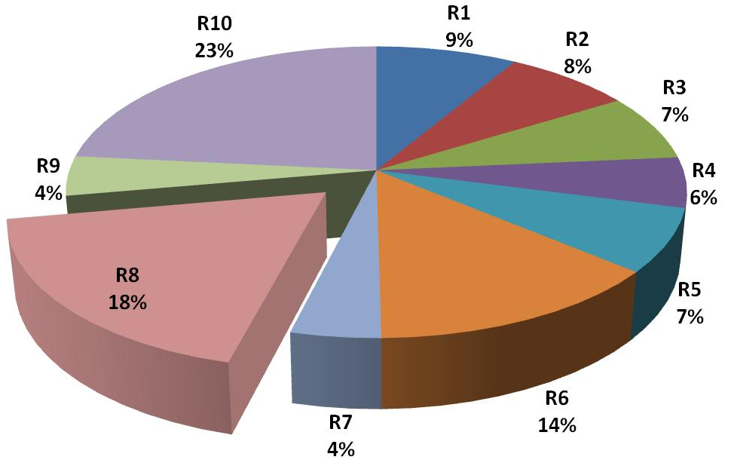
Percent of total IEEE Membership by Region
R8 is Second largest in terms of number of members.

Slide 33

R8 Organizational Units data
59 Sections
10 Subsections
1 Council: Africa Council
600+ Society Chapters
100+ Affinity Groups
660+ Student Branches
390+ Student Branch Chapters
100+ Student Branch Affinity Groups

Slide 34
‘Average’ Region 8 Section
1,100 Members
(largest ca. 9,500)
(median ca. 500)
(smallest ca. 50)
18 OU’s
(with ca. 40 members)
  9 Chapters,
  1 Affinity Group,
  6 Student Branches,
  1 Student Branch Chapter,
  1 Student Branch Affinity group.

Slide 35
IEEE Region 8 Vision and Mission
Mission
To serve the needs of the members of the Institute, the profession and society at large, by enhancing and supporting the IEEE’s Organizational Units and their activities within Region 8.
Vision
Region 8 is an effectively organized, dynamic and influential entity, recognized as a leading and esteemed part of a truly transnational IEEE, with IEEE benefits equally available to all members.

Slide 36
Key steps to realize the mission
Provide a platform for coordination, motivation and interaction among Region 8 units.
Provide a link between the Region and other IEEE organizational units.
Work to achieve smooth and effective operations in different countries
  recognizing cultural differences, and
  effectively cooperating with national societies and other organizations.
Expand IEEE presence and activities to new geographic areas in Region 8.
Promote the transnational nature of IEEE within the Region and the Institute.

Slide 37
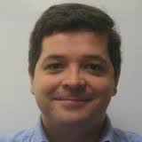
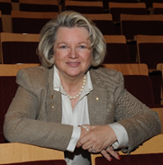
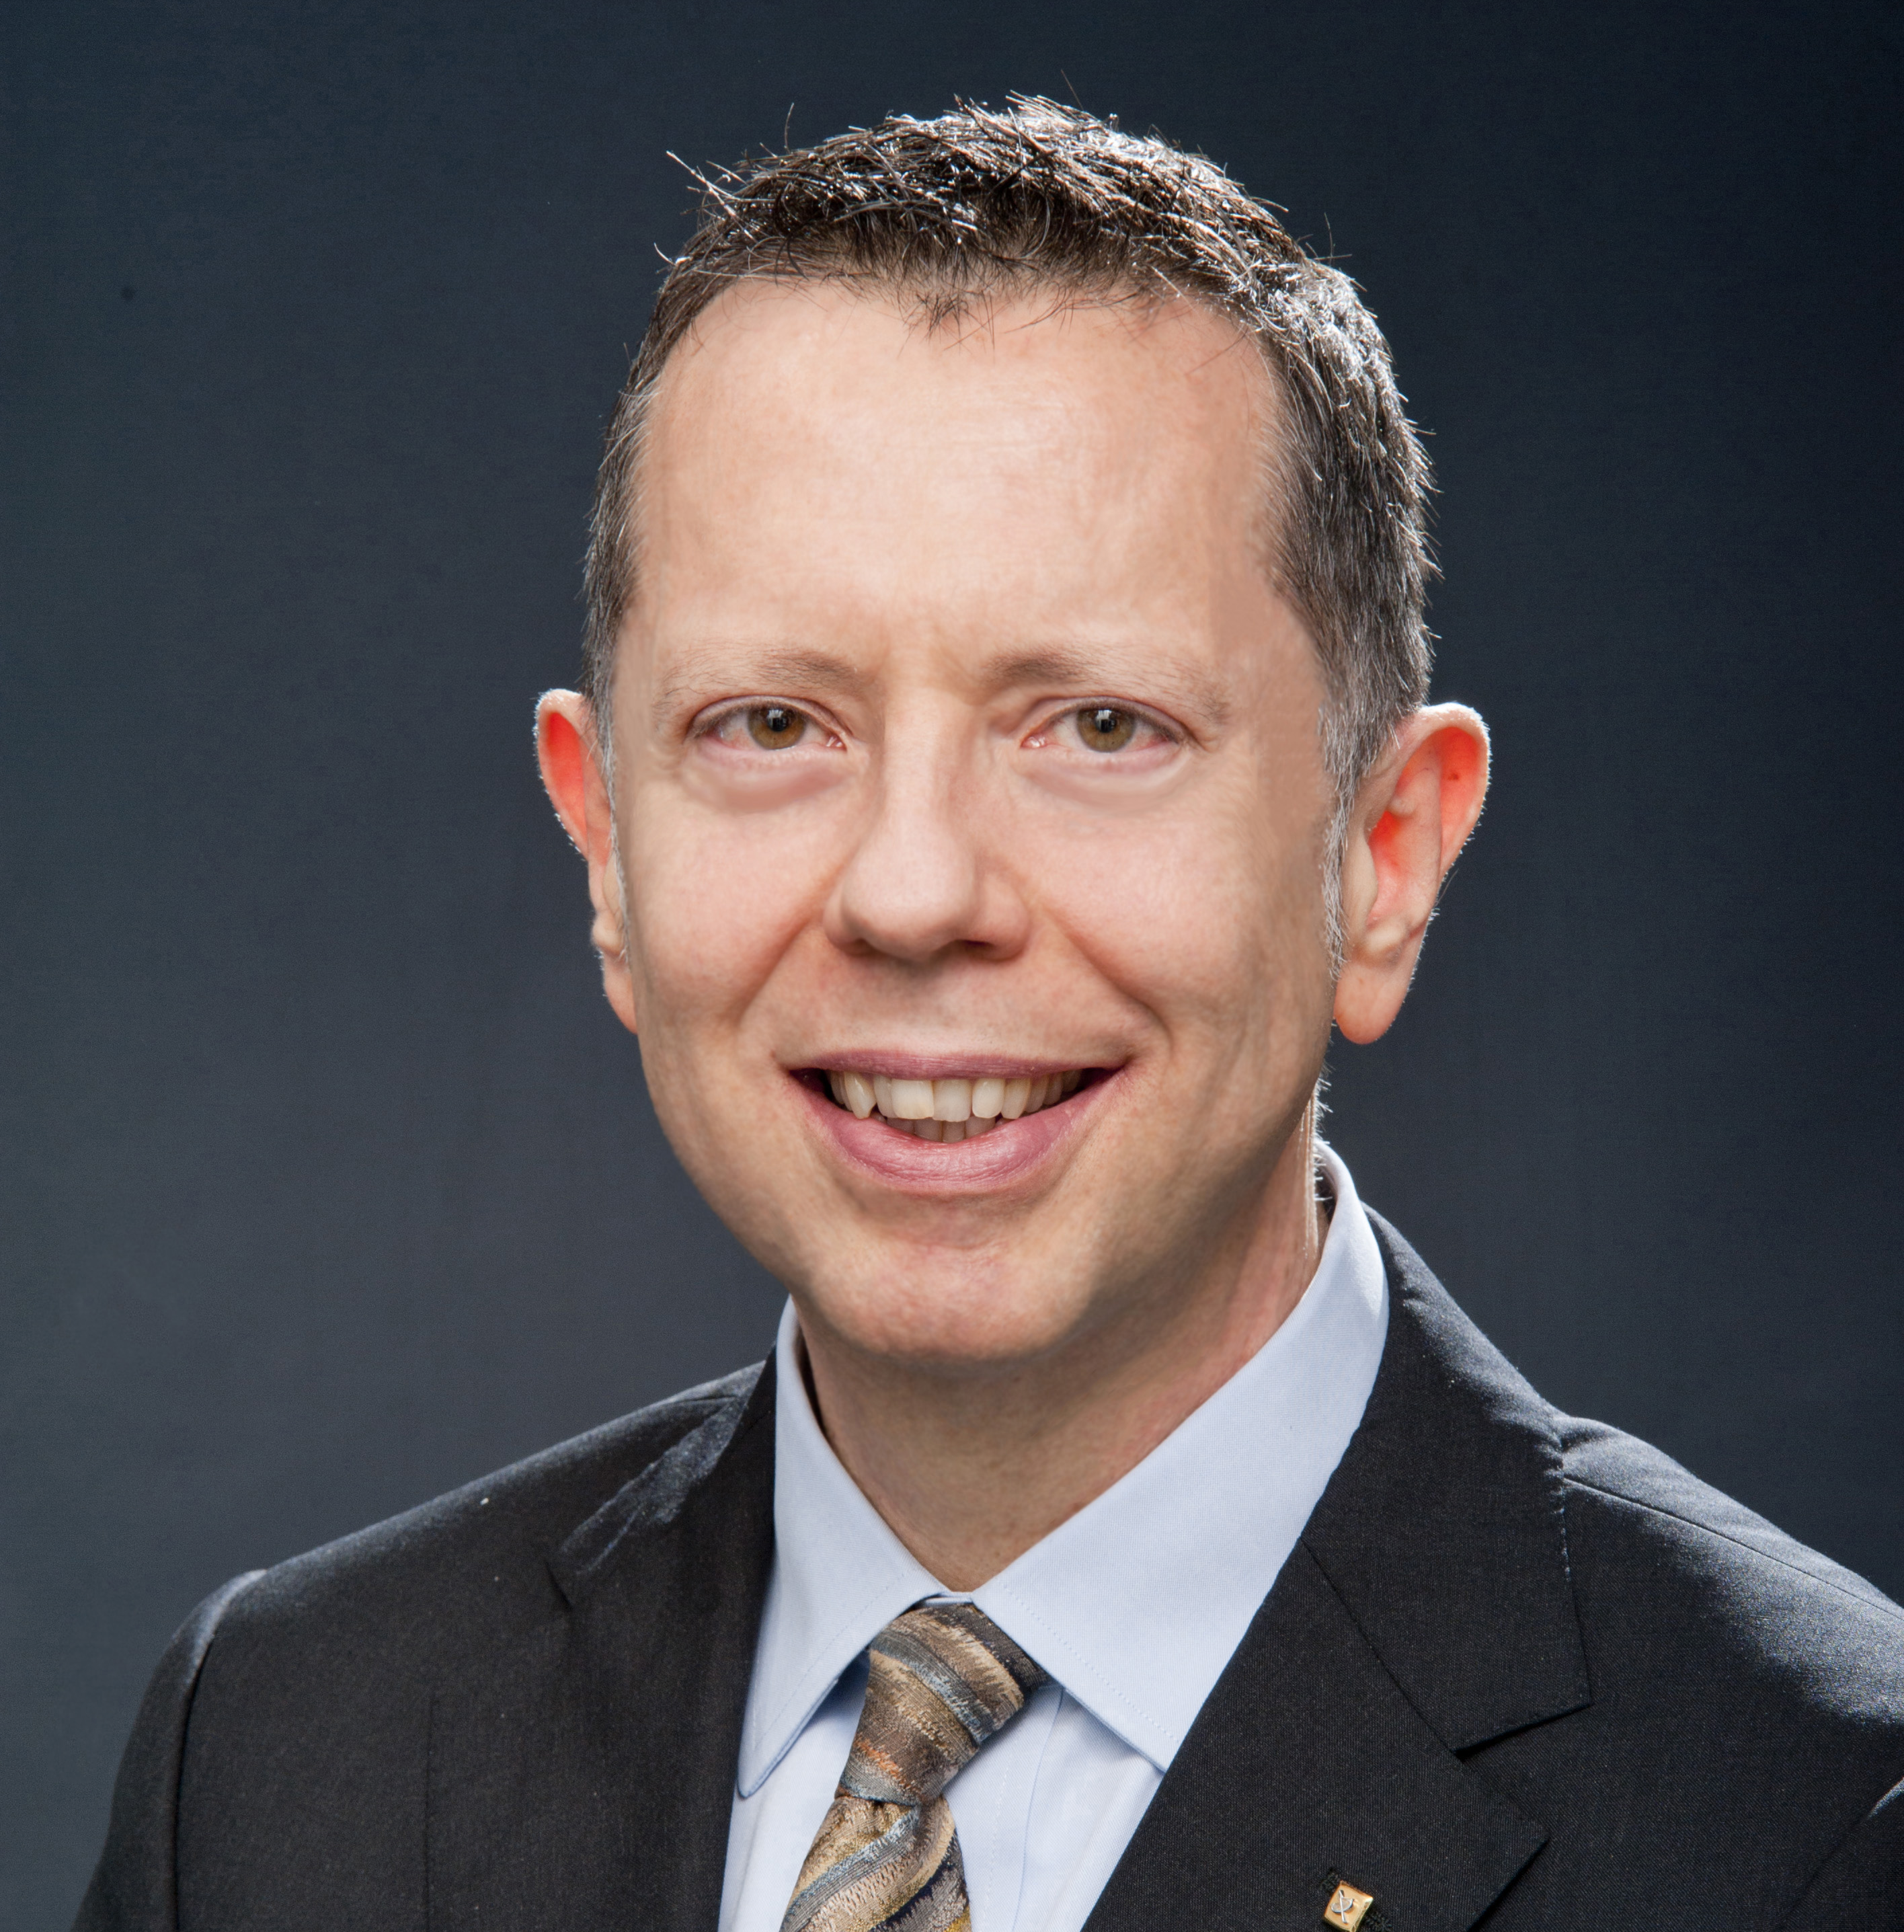
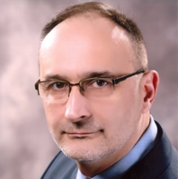
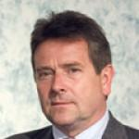

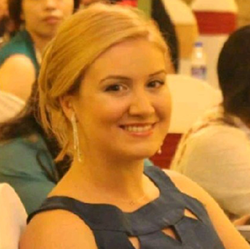
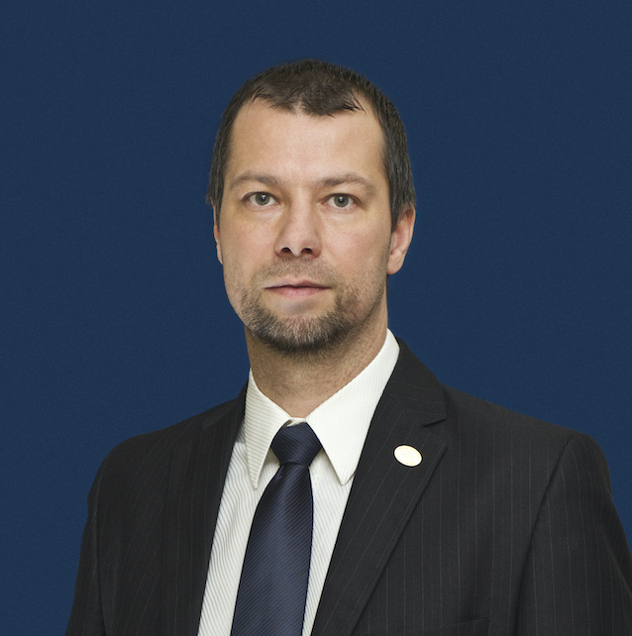
R8 Operating Committee (OpCom)
Antonio Luque
Magdalena Salazar-Palma
Vincenzo Piuri
  Ljupco Karadzinov
Adam Jastrzebski
Sara Barros
Simay Akar
Peter Nagy

Slide 38
R8 Committee members
OpCom
  Director: Antonio Luque (Spain)
  Director-Elect: Vincenzo Piuri (Italy)
  Past-Director: Magdalena Salazar Palma (Spain)
  Secretary: Ljupco Karadzinov (North Macedonia)
  Treasurer: Adam Jastrzebski (UK & Ireland)
  Vice-Chair, Member Activities: Sara Barros (Benelux)
  Vice-Chair, Student Activities: Simay Akar (Turkey)
  Vice-Chair, Technical Activities: Peter Nagy (Hungary)

Slide 39
R8 Committee members
Complete listing
  https://ieeer8.org/category/committee/
All Section Chairs:
http://www.ieeer8.org/category/sections/

Slide 40
R8 Committee - Appointed members
  Action for Industry: John Matogo (Kenya)
  Awards & Recognition: Magdalena Salazar Palma (Spain)
  Chapters: Andrejs Romanovs (Latvia)
  Conferences: Habib Kammoun (Tunisia)
  Humanitarian Activities: Abdulateef Aliyu (Nigeria)
  Membership Development: Mike Hinchey (UK & Ireland)
  Professional and Educational Activities: Conrad Attard (Malta)
  Region 8 News: Cátia Bandeiras (Portugal)
  Standards Coordinator: Tuncer Baykas (Turkey)
  Strategic Planning: Magdalena Salazar Palma (Spain)
  Student Representative: Theodoros Chatzinikolaou (Greece)
  Women in Engineering: Maria Alexandra Paun (Switzerland)
  Young Professionals: Almedin Kavaz (Germany)

Slide 41
R8 Committee - Appointed members
  Africa Council Chair: Vincent Kaabunga (Kenya)
  Careers New Initiative: Mohamed Amin (Egypt)
  Diversity, Equity and Inclusion: Mona Ghassemian (UK & Ireland)
  Electronic Communications: George Michael (Cyprus)
  Electronic Communications Assistant: Maria Efthymiou (Cyprus)
  Finance: Adam Jastrzebski (UK & Ireland)
  History Activities: Martin Bastiaans (Benelux)
  Life Members: Peter Magyar (Germany)
  New Industry Events Initiative: Nihal Sinnadurai (UK & Ireland)
  New Student Contests Initiative: Lee Crudgington (UK & Ireland)
  Publications and Communications: Adeel Sultan (United Arab Emirates)
  Region 8 Sigma: Christopher James (UK & Ireland)
  Region 8 Today: Hazar Oklah (Jordan)
  Region Vitality Coordinator: Matej Zajc (‎Slovenia)
  Sections Congress Coordinator: Costas Stasopoulos (Cyprus)
  Congress (SYP/xSYP) Coordinator: Barbara Vujkov (Serbia)
  Social Media: Mohamed Hussain Babaee (Portugal)
  Voluntary Contribution Fund: Andreas Koltes (Germany)

Slide 42
Africa Council
Africa has 10 Sections, 6 Sub-Sections and more than 6,000 active members across the continent’s 54 countries as of 2016.
Africa Council was approved in June 2018 and is now fully operational.
Its primary responsibility is to be a centralized coordinating unit for IEEE activities in Africa. Other responsibilities are to provide:
  Guidance to the members on how to use IEEE’s tools, products and network to enhance the engineer in Africa.
  A common voice for IEEE on the continent and provide an initial point of contact.
  Volunteer development training to grow IEEE’s presence in Africa to benefit all volunteers.
With the Africa Council, it is easier to identify solutions to problems in Africa. More importantly, African volunteers will get more opportunities to know themselves, network and share ideas and best practices for professional development.

Slide 43
What does R8 Committee do?
Conducts two annual meetings with the Region’s leadership:
  coordination of Region 8 business,
  ultimate decision body for matters under Region responsibility,
  training for new volunteers.
Supports activities of local Organizational Units.
Coordinates meetings for technical and professional purposes in the Region.
Coordinates student, Young Professionals and Women in Engineering events.
Coordinates activities between R8 entities and Organizational Units from outside the Region.
Engages in member development.
Web site: www.ieeer8.org

Slide 44
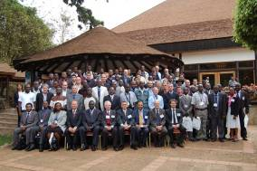
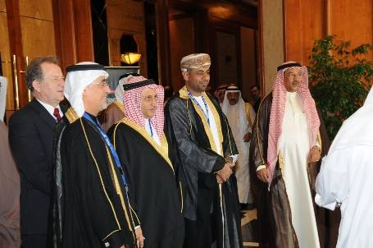
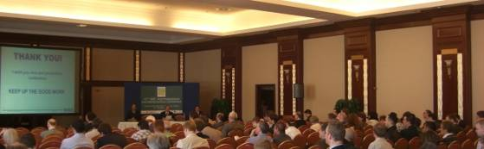
R8 Conferences
EuroCon
MeleCon
AfriCon
EnergyCon
HistelCon
Approximately 300 IEEE conferences in Region 8 every year:
  Some of them technically co-sponsored.

Slide 45
Coming R8 Flagship Conferences
EUROCON 2021, July 2021, Lviv, Ukraine (online conference)
HISTELCON 2021, August 2021, Moscow, Russia
AFRICON 2021, September 2021, Arusha, Tanzania
International Humanitarian Technology Conference (IHTC) 2021, December 2021, Brighton, United Kingdom (online conference)
ENERGYCON 2022, May 2022, Riga, Latvia
MELECON 2022, June 2022, Palermo, Italy

Slide 46
Sponsoring Conferences
Sections can sponsor conferences.
Sections can co-sponsor or technically co-sponsor conference, but only with non-for-profit entities
For co-sponsored and technically co-sponsored conferences, the Section must sign a Memorandum of Understanding with the other parties.
The decision to sponsor, co-sponsor or technically co-sponsor a conference must be recorded in the Section's meeting minutes. Review the application for sponsorship to make sure that the conference is a success and the quality is high.
The Section should participate in the conference to gauge quality.
If the Section needs advice, contact Region 8 Conference Coordinator.
www.ieeer8.org/category/technical-activities/conference-coordination/

Slide 47
New Technical Co-Sponsor (TCS) Fee
For all conferences starting 1 January 2021 or later, in which an MGA Geographic Unit is a technical co-sponsor and there is no IEEE financial sponsorship, the MGA TCS Fee policy shall apply.
  This fee is $1500 per TCS conference, and $22 per paper submitted to IEEE Xplore.
  If multiple IEEE Organizational Units (OUs) technically co-sponsor the same conference, the fee will be divided equally between all IEEE sponsors (i.e.: Society, Technical Council, MGA Geographic Units).
  MGA Geographic Units will have the option to bill the TCS fees directly to the Conference.

Slide 48
Supporting Members and Volunteers
Communications and Publications
Professional and educational activities
Members services and recognition
Activities for industry and professionals
Humanitarian activities
Diversity and inclusion

Slide 49
GDPR
The General Data Protection Regulation (GDPR), originating in the European Union, is expected to have far-reaching implications on how organizations, like IEEE, conduct business worldwide, including conferences.
  This regulation places new obligations on organizations that market, track, or handle personal data.
  Went into effect on 25 May 2018.
  News at R8 website: http://ieeer8.org/news/new-gdpr-regulation-impacts-for-ieee-conferences
  Most important information: http://sites.ieee.org/gdpr

Slide 50
Running a Section Successfully

Slide 51
What a Section Chair does
Runs the Section, by promoting, supporting, coordinating and overviewing all activities of the Section.
Finds future leaders.
Be a role model.
Inspires and mobilizes people.
Organizes Administrative board meetings.
Supports activities:
  Professional,
  Technical,
  Non-technical (including social).
Reports to officers – important!
  So they receive e-mail, information material, and so on.
Reports to Region 8 and IEEE – important!

Slide 52
Election of Section’s and Chapter’s Officers
All officers shall be elected annually or biannually,
Term of office is 1 January to 31 December,
An officer should not serve in the same position for more than four consecutive years, or for more than six years in total.
See MGA Operations Manual, Section 9.4.F: http://www.ieee.org/documents/mga_operations_manual.pdf
The Section/Chapter must report the change of Officers/volunteers as soon as possible.
  To ensure the IEEE Geographic Roster will be updated.
  Ensure volunteers have access to IEEE MGA services:
    OU Analytics (web-based ad hoc query tool that provides volunteers access to member data, http://www.ieee.org/ouanalytics ),
    vTools (wide range of tools developed by volunteers for IEEE members and IEEE volunteers: http://sites.ieee.org/vtools/ ),
    Entity Web Hosting (service to develop, create and maintain websites on an IEEE host: http://sites.ieee.org/ ).
IEEE Officer Confirmation Report: http://officers.vtools.ieee.org/

Slide 53
Positions/areas of responsibility in IEEE Geographic Roster for a Section
Chair,
Vice Chair,
Secretary,
Treasurer,
Secretary/Treasurer,
Industry Ambassador,
Professional Activities,
Educational Activities,
Student Activities,

Slide 54
Positions/areas of responsibility in IEEE Geographic Roster for a Section
Membership Development Chair,
Chapter Coordinator,
Affinity Groups Chairs (Young Professionals, Women in Engineering,…)
Conference Coordinator,
Newsletter,
Electronic Communications Coordinator,
Awards and Recognition Chair,
Historian,
OU Analytics and membership database,
Nominations and Appointments Chair,
…

Slide 55
Meeting Reports
Meeting Reports: https://events.vtools.ieee.org/tego_/authentication/sign_in?_landing=/meeting_report/search

Slide 56
Section Vitality Checklist
From MGA Operations website
First Quarter of the Year (January – March)
Complete and submit all IEEE mandated documentation (e.g. Meeting Reports, Financials (NetSuite/ L50) to close the previous year.
Report all Section Officers, Affinity Group, Chapter, and Student Branch Chairs.
Update Section website.*
Does your Section have Social Media presence (Facebook, Instagram, etc)
Train new officers through the Center for Leadership Excellence.
Are you familiar with vTools?
Promote use of Section Vitality Dashboard, vTools and OU Analytics. *
Review /Update local operating procedures.
Plan and budget for Section, Chapter, and Affinity Group activities for the year.
Organize a workshop for Chapter and Affinity Group Chairs.
Conduct joint meeting with student branches, e.g. technical presentation, Student Professional Activities Conference (S-PAC).
Reach out to non-renewing members before the deactivation date (end of February)
Review meeting reporting on vTools for all local units and bring it up to date
* Activities marked with an asterisk should be conducted throughout the year.

Slide 57
Section Vitality Checklist
Second Quarter of the Year (April – June)
Conduct a Membership Development activity (e.g. membership recruitment or elevation meeting). Half-year dues cycle starts in March. Contact deactivated members and ask them to renew.
Conduct Professional Development Activities (e.g. workshop/seminar).
Conduct a Continuing Education activity.
Establish a plan for engaging with members in industry.
Communicate with section members on IEEE activities (e.g. webinar).
Engage with Regional Leadership and activities (e.g. attend annual regional meeting).
Review Affinity Group and Chapter activities to ensure continuity.
If there are no affinity groups or chapters in the Section, strive to form one using OU Analytics to gauge members’ interests.*
* Activities marked with an asterisk should be conducted throughout the year.

Slide 58
Section Vitality Checklist
Third Quarter of the Year (July – September)
Promote a pre-university activity in your area (e.g. TISP, science fair judging).*
Conduct a Career Workshop (e.g. resume writing, employment network).*
Submit nominations for awards (e.g. MGA, TA, and Region). Solicit nominations for Section Awards.
Establish partnership with industry (e.g. joint technical presentation/training).*
Conduct joint meeting with student branches (e.g. student training, STEP event).
Support an affinity group function in conjunction with the section.
Recruit new volunteers.*
Solicit nominations for leadership roles for the upcoming year and develop the slate for elections.
* Activities marked with an asterisk should be conducted throughout the year.

Slide 59
Section Vitality Checklist
Fourth Quarter of the Year (October – December)
Encourage members to renew
Conduct an event to support involvement with local industry.*
Hold Officer Elections.
Share and collaborate on humanitarian/community engagement projects.*
Conduct a Membership recruitment event (e.g. social event).
Organize an Annual Dinner with Section Awards.
Communicate with the Section membership and announce new officers
Are elections held annually?
Did you have an election in the last 2 years?
* Activities marked with an asterisk should be conducted throughout the year.

Slide 60
Geographic Unit Operations Resources
www.ieee.org/societies_communities/geo_activities/resources
IEEE Center for Leadership Excellence –
Training for Geographic Unit Leaders ( https://ieee-elearning.org/CLE/ ).
Required reporting for Geographic Units.
IEEE Organization Roster (www.ieee.org/roster).
IEEE e-Notice (www.ieee.org/enotice).
OU Analytics (www.ieee.org/ouanalytics).
vTools (vtools.ieee.org).
Request for letter to employer.
Formation and Petitions, Section Bylaws and Addendums, Affinity Groups, Chapters, Ordering products.

Slide 61
Center for Leadership Excellence (CLE)
www.ieee.org/cle
Serves as the repository for all leadership training material within IEEE to ensure IEEE keeps pace with its evolving organization.
Meets the needs of IEEE volunteer leadership by providing materials that will enable volunteers to accomplish their jobs efficiently and effectively, to ensure that members are engaged in IEEE activities, to increase IEEE member satisfaction, and to grow IEEE relevance for members.
Makes information easily available with a Learning Library in key areas of education and training.
Provides access to full course material for volunteering positions which will provide a one place to go for all their training needs. This includes a Quick Start module to help come up to speed during their first 30 days in their position, a job description for their role, time line of key dates and recommended training modules that support the particular aspect of their role.
Contains an IEEE Glossary!

Slide 62
Sections Congress
IEEE Sections Congress is a triennial gathering of Section leadership sponsored by the Member and Geographic Activities (MGA) Board.
It is the one major meeting sponsored by IEEE that brings together the grassroots leadership of IEEE so that they can share ideas, concerns, and solutions.
It is also a forum where the Section Chairs speak as the collective voice of IEEE members, expressing ideas about how IEEE can better serve its members, both now and going forward. The issues generated at Sections Congress have had a major impact on the plans made by the IEEE leadership for the future of IEEE.
It involves hundreds of delegates from all ten Regions who have a unique opportunity to learn how to utilize the resources of IEEE to maximize their effectiveness as IEEE volunteer leaders.

Slide 63
Sections Congress
With workshop, panel, and tutorial sessions held on topics of interest to the Sections during several days of working sessions and networking.
Each Region prepares recommendations that are voted by all Sections Congress delegates. The top five are considered by MGA and IEEE for their plans.
Past Sections Congress:
  Sections Congress 2017 in Sydney, Australia, at the International Convention Centre, from 11 to 13 August 2017.
  Theme: Brilliant Minds, Bright Futures
Coming Sections Congress:
  2021-2022: online meetings and training
  2023: in person meeting
  http://sections-congress.ieee.org/

Slide 64
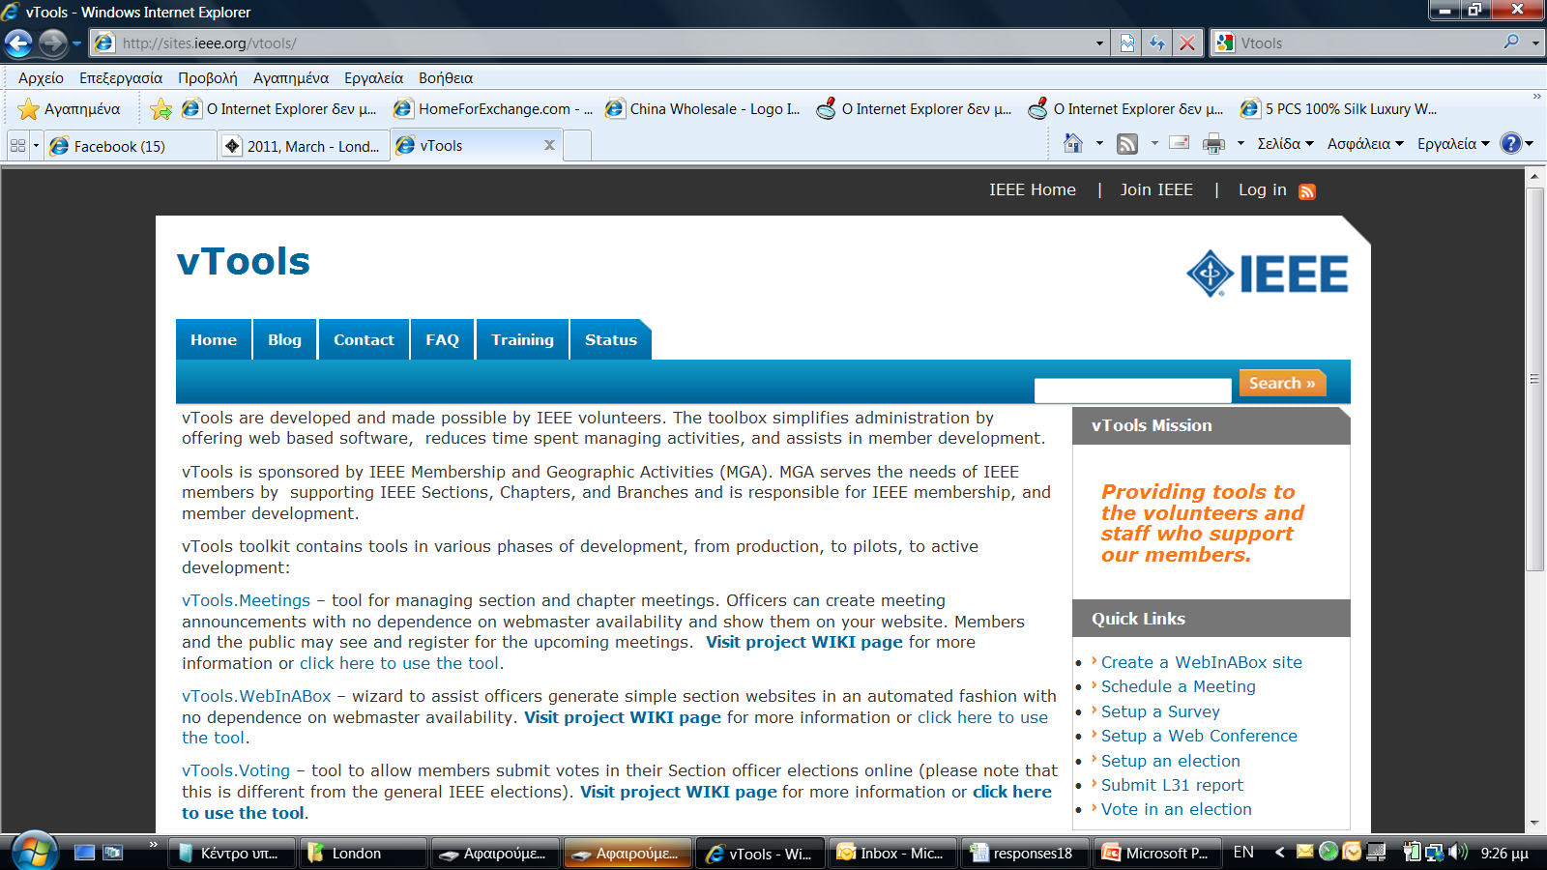
vTools
Notes:
Update screenshot

Slide 65
vTools: *.vtools.ieee.org
Events – manage Section and Chapter meetings and events (https://events.vtools.ieee.org/ ).
Voting – submit votes in Section officer elections.
Officers – report new officers or officer changes.
SBR (Student Branch Reporting) – collecting and search reports submitted by student branch volunteers.
WebEx – a Web Conferencing service to Geographic Organizational Units for online meetings, webinars, training, demos and presentations.

Slide 66
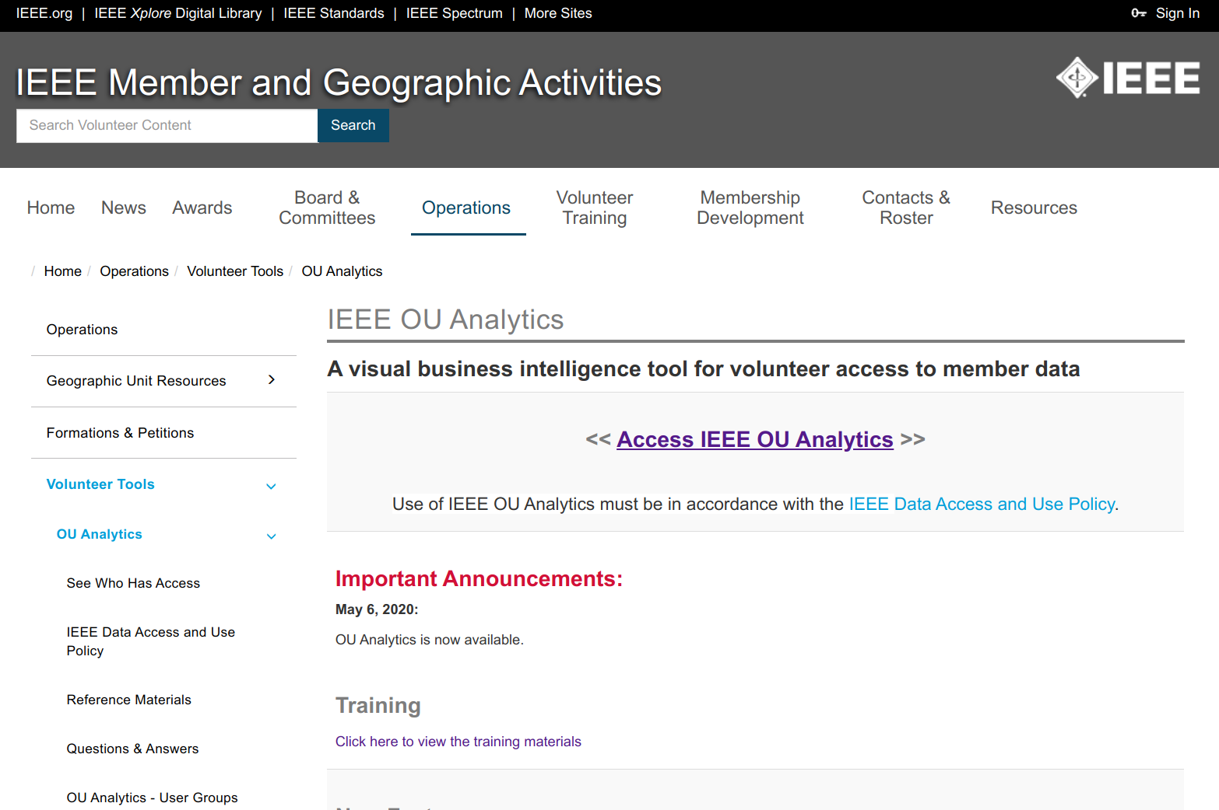
OU Analytics
http://www.ieee.org/ouanalytics

Slide 67
OU Analytics
Memberships and statistics
  Numbers and details of members
  Subscriptions and membership
  Year Over Year Comparison (Geographic Membership Statistics Dashboard)
Volunteers
  Officer history
  All current officers (Geographic roster)

Slide 68

Promoting and Facilitating Volunteering
https://volunteer.ieee.org/

Slide 69
Promoting and Facilitating Volunteering
Matching volunteering opportunities with volunteers’ desire of helping our scientific and professional community and IEEE to fulfill its mission.
Micro-volunteering.
Listing the available volunteering services in conferences, meetings, industrial and professional services, career development, student activities, educational activities, humanitarian activities, members services, Section/Chapter promotion and activities, ….
Searching for volunteers with appropriate skills and experiences
Offering competences and skills
Searching for available opportunities for serving our community

Slide 70
MGA rules for rebate to Sections
All Sections in existence on 31 December and meeting minimum requirements receive a
USD 2,000 annual allowance.
USD 3 for each Member, Student, or Associate member,
USD 1.50 for Affiliate,
USD 4 for Senior or Fellow member.
USD 200 for each chapter and/or affinity group meeting minimum requirements.
10% bonus of total rebate to sections who report (financial, meeting, and officer) by deadline.

Slide 71
MGA rules for rebateto Subsections
All Subsections in existence on 31 December and meeting minimum requirements receive a
USD 500 annual allowance:
  Minimum of 5 meetings,
  Maintain at least 15 members.

Slide 72
MGA rules for rebate – Activity bobus
Activity bonus: to encourage local activities:
All sections (subsections) reporting 10 or more meetings, at least five of which must be of a technical nature, receive an additional USD 200 (USD 100 to Subsections),
All chapters or affinity groups reporting
6 or more meetings of a technical nature shall receive an additional USD 75,
Joint meetings may be counted toward only one unit’s bonus.
All units must qualify for the timely reporting bonus in order to be eligible for an activity bonus.

Slide 73
MGA rules for rebate:
Activity and reporting requirements
Current officer report: Reports of current section, subsection, chapter, and affinity group officers must be submitted within 20 days following the election and/or appointment of officers.
Financial report: summary of previous year's financial activities must be submitted annually. If the section is unable to obtain financial records from a subsection, chapter, or affinity group, it may opt to submit a statement that the subunit has failed to submit a timely financial report and waive its right to a rebate for that particular subunit.

Slide 74
MGA rules for rebate:
Activity and reporting requirements
Bank signature card: The bank signature card(s) must be returned to the IEEE Operations Center for the signature of the IEEE Staff Director-Financial Services before the section rebate will be released.
This is required for all bank accounts for Units outside of the US where banking and legal restrictions will allow.
Meeting Activity Report(s): Meeting activity reports are key to unit maintenance and viability. Submit a Meeting Report Form (L31) via the Web for each meeting.

Slide 75
Overview of Member and Geographic Activities and MGA Board

Slide 76
Member and Geographic Activities
IEEE Member and Geographic Activities (MGA) is focused on supporting and meeting the members' needs and IEEE membership recruitment and retention strategies and implementation.
IEEE local geographic organizational units (Sections, Chapters, Affinity Groups, and Student Branches) provide unique opportunities for members to attend technical presentations, create strong peer-to-peer connections, and participate in leadership opportunities that can make a positive distinction in IEEE members' jobs and careers.
The IEEE Member and Geographic Activities Board (MGA Board) is responsible to the IEEE Board of Directors, has oversight of IEEE geographic organizational units, and is responsible for IEEE membership and member development.

Slide 77
Member and Geographic Activities
MGA mission
Inspire, Enable, Empower and Engage Members of IEEE.
For the purposes of:
  Fulfilling the mission of IEEE,
  Enhancing the members growth and development through their life cycle,
  Providing a professional home.
MGA vision
Ensure quality member opportunities for continuous engagement.

Slide 78
Member and Geographic Activities
mga.ieee.org
MGA Home (News; Vision and Mission; Geographic Units).
MGA News (with an archive of former issues of Scoop).
MGA Board.
Geographic Unit Operations Resources.
Regional World Map.
MGA Committees, Agendas, and Reports.
MGA Nominations and Appointments.
MGA Awards and Recognition Program.
MGA Operations Manual.
MGA Department (Staff).

Slide 79
MGA Board
Chair and Vice President, MGA (Maike Luiken).
VP-Elect (David Koehler).
Past Chair (Kukjin Chun).
Secretary (Cecelia Jankowski).
Treasurer (Gerardo Barbosa).
10 Region Directors.
3 Vice Chairs:
  Member Development (Francisco Martinez),
  Geographic Unit Operations (Costas Stasopoulos),
  Information Management (Ron Jensen),
2 Members-at-Large (Rangachar Kasturi, Murty Polavarapu)
2 TAB Representatives (Murty Polavarapu, Imre Rudas).
IEEE-SA Liaison (Shmuel Auster)
https://www.ieee.org/societies_communities/geo_activities/mga_board.html

Slide 80
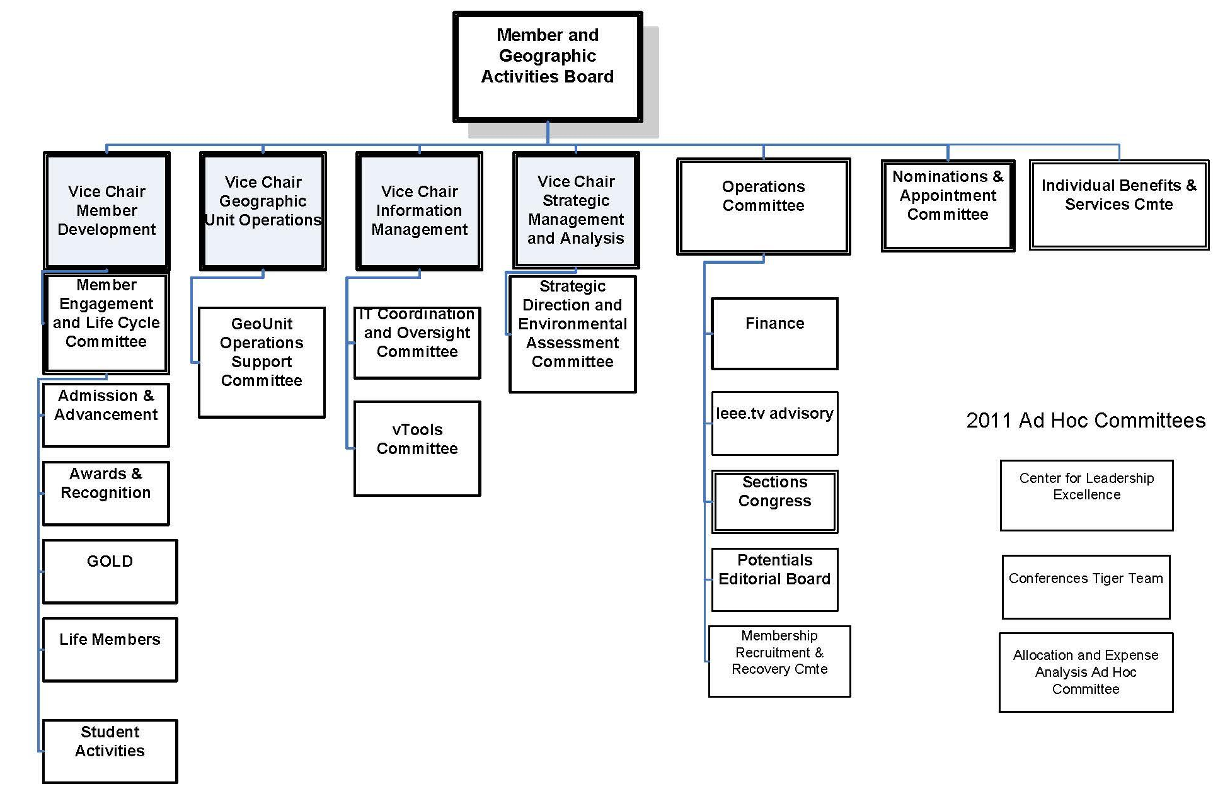
MGA Board and Committees Structure
Other Committees
YP
Training Committee
Member Benefits Portfolio Advisory Committee
WIE

Slide 81
MGA Operations Manual
Introduction
Member and Geographic Activities Board
MGA Financial Matters
MGA Committees
MGA Operations Committee
MGA Assembly
MGA Nominations and Appointments Process
Member and Geographic Activities Awards
Geographic Organizational Units
Conferences
MGA Publications
Revisions to the MGA Operations Manual

Slide 82
Member Strategy Team
Director, Member Strategy
Member Data and Research
Membership Statistics
Member Satisfaction
Member Studies
Measuring Engagement
Alternate Models
Dashboards
Membership Development
MD Materials
MD Support
Membership Promotion
Student Programs
Affinity Groups
Benefit Promotion
Campaign Coordination
Marketing Operations
Product Management
myIEEE
memberNet
IEEE.tv
Mentoring Connection
Benefit Portfolio Mgmt
New Benefit Process
Financial Mgmt

Slide 83
Member Operations Team
Staff Director, Member Operations
Member Processing
Join
Renew
Add societies
Add Publications
Change address
Update profile
Contact Center
Member Questions
Computer access
Recover password
Order products
Payment Resolution
Magazine Replacement
Administration
Project Management
Budgeting
Financial forecast
Process Management
Work flow
Results measurement
Productivity

Slide 84
Information Management Team
Director, Information Management
Member Experience
Join
Renew
Add Societies / Subscriptions
eNotice
EWH
- Online Communities
- Training
SAMIEEE
vTools
Volunteer
Tools
Operations
Back Office Processes
- Project Management
Web Presence

Slide 85
Finance and Administration Team
Director, Finance and Administration
Finance
Planning
Forecasting
Budgets
Financial Analysis
Business Models
Monthly Reporting
Geo Unit Reporting
L50 Reports
Tracking
Internal Controls
Compliance
Banking Transactions
Region Financial
Transactions
Advise and support
Section Treasurers
Monthly Assessment
Summaries
Custody Accounts

Slide 86
Geographic Activities Team
Director, Geographic Activities
Regulatory
Compliance
Geo Unit Operations
Section Operations
Volunteer Training
Processes
Geo Unit Administration
Volunteer Inquiries
Historical Research
Meeting Reports
Recognition Products
Geo Unit Formations
Policy Management - Volunteer Development
MGA Board Operations - Volunteer Recognition
Committee Support
Governance

Slide 87
Region 8 Committee Meetings

Slide 88
A typical R8 committee meeting
What will happen?
Committee members are the real stars of the meetings. Everything will be presented, reported, or asked to you.
During the meeting you can expect reports from the different R8 officers and committees; presentations from invited IEEE leaders and staff; healthy discussion about matters pertaining to the Region, the Sections or the members.
The Region Director will chair the meeting and will take care of the order, timing, and progress of items.
Don’t be shy! Participate, share your opinion and listen to others!

Slide 89
How is the meeting organized
The meeting will start with a roll call, when everybody in the room is asked to identify themselves.
The meeting has an agenda. At the beginning you will be asked to approve it. The agenda has been posted at the meeting page on the R8 website.
Then you will be asked to approve the consent agenda. The items there are supposed to be of non-controversial nature. But everybody is entitled to take items out of the consent agenda. If you feel that something needs to be discussed, just raise your hand at this moment.
Then the next items in the agenda will follow, starting with the welcome from the Director. Rules of order will be followed.

Slide 90
Motions
A motion is a request for the body (the R8 Committee) or some of its members (committees, appointed persons, officers) to do something. As such, a motion always has to have an element of action.
Motions will be presented, discussed and voted.
Any member has the right to propose or discuss a motion. Only those with voting rights will be allowed to vote.
More on motions later.

Slide 91

Rules of order
Rules of order, also known as
standing orders or rules of procedure,
are the written rules of parliamentary procedure adopted by a deliberative assembly, which detail the processes used by the body to make decisions.
IEEE Bylaws I-300. Management
Robert's Rules of Order shall be used to conduct business at meetings of the IEEE Board of Directors, Major Boards, Standing Committees and other organizational units of the IEEE unless other rules of procedure are specified in the Not-For-Profit Corporation Law of the State of New York, the IEEE Certificate of Incorporation, the IEEE Constitution, these Bylaws, the IEEE Policies, resolutions of the IEEE Board of Directors, or the applicable governing documents of those organizational units provided such organizational documents are not in conflict with any of the foregoing.

Slide 92
Rules of order in R8 Committee
All members of the Committee have equal rights to participate and take part in debate, except that non-voting members do not have the right to vote.
Substantial parts of a meeting are organised in an informal way.
Formal parts of meetings are normally conducted in accordance with Robert’s Rules.
  Robert’s Rules are not well known in the countries of Region 8, it cannot be assumed that the R8 Committee members have more than a superficial familiarity with these rules, and this must be allowed for in the conduct of the meetings.
The Chair should enable an orderly debate to take place on all issues, and allow equal and fair rights to all members of the Committee.
During formal debates, the Chair must take a neutral position and may only vote in the case of secret vote or to break a tie.

Slide 93
Main ideas
Rules of order are used to simplify the parliamentary procedure, not to complicate it.
Everyone has the right to speak once if they wish, before anyone may speak a second time.
Everyone has the right to know what is going on at all times.
Only urgent matters may interrupt a speaker.
The members discuss one thing at a time.

Slide 94
The basics of the rules
One thing at a time. Only one main motion is allowed on the floor at a time, but there is a system to put that motion aside if something more urgent comes up.
One person, too. Only one person may talk at a time.
And only one time per meeting. The same motion (or practically the same) can not be made more than once per session; the only exception is if a member changes his or her mind.
Enough of us have to be here to decide. The group determines the minimum number of people (called a quorum) that must be present to make a decision for the whole group.
Nancy Sylvester, “The complete idiot’s guide to Robert’s rules,”
ISBN 1-59257-163-8, Alpha, Indianapolis, IN, 2004.

Slide 95
The basics of the rules (cont’d)
Protected even if absent. The rights of the members who are absent are protected.
Vote requirements are based on members’ rights. The determination of what kind of vote is needed (such as majority, two-thirds, ...) is based on members’ rights. If an action gives rights to the members, it requires a majority vote to pass. If an action takes away rights from members, it requires a two-thirds vote to pass.
Silence = consent. If a member chooses to abstain from voting, that member is giving his or her consent to the decision made by the group.
Everybody is equal. All voting members have equal rights. The majority rules but the minority has the right to be heard and to attempt to change the minds of the majority.

Slide 96

How to do things …
You want to bring up a new idea before the group.
After recognition by the chair, present your motion.
A second is required for the motion to go to the floor for consideration (and the motion now belongs to the body).
You want a motion just introduced by another person to be killed.
Without recognition from the chair, state “I object to consideration.”
This must be done before any debate.
This requires no second, is not debatable and requires a 2/3 vote.
You want to change some of the wording in a motion under debate.
After recognition by the chair, move to amend by adding words, striking words or striking and inserting words.
This may be recognised as a friendly amendment by the person (or body) who proposed the original motion.

Slide 97
How to do things …
You like the idea of a motion under debate,
but you need to reword it beyond simple word changes.
Move to substitute your motion for the original motion.
If it is seconded, debate will continue on both motions and eventually the body will vote on which motion they prefer.
You feel the motion addresses two or more separate issues.
Move to divide the question.
You want more study and/or investigation given to the idea under debate.
Move to refer to a committee.
Be specific as to the charge to the committee.
You want more time personally to study the proposal under debate.
Move to postpone to a definite time or date.

Slide 98
How to do things …
You want to postpone a motion until some later time.
Move to table the motion.
The motion may be taken from the table after one item of business has been conducted.
If the motion is not taken from the table by the end of the next meeting, it is dead.
You have heard enough debate.
Move to call the question; this cuts off debate and brings the assembly to a vote on the pending question only.
Requires a 2/3 vote.
You want to take a short break.
Move to recess for a set period of time.
You want to end the meeting.
Move to adjourn.

Slide 99
How to do things …
You are unsure that the chair has announced
the results of a vote correctly.
Without being recognized, call for a “division of the house."
At this point a standing vote will be taken.
You are confused about a procedure being used and want clarification.
Without recognition, call for “Point of Information” or
“Point of Parliamentary Inquiry.”
The chair will ask you to state your question and will attempt to clarify the situation.
You have changed your mind about something that was voted on earlier in the meeting for which you were on the winning side.
Move to reconsider.
If the majority agrees, the motion comes back on the floor
as though the vote had not occurred.

Slide 100
Summary of RRO
You may INTERRUPT a speaker for these reasons only:
to get information about business – point of information
to get information about rules – parliamentary inquiry
if you can't hear, safety reasons, comfort, etc. – question of privilege
if you see a breach of the rules – point of order
if you disagree with the chair's ruling – appeal
You may influence WHAT the members discuss:
if you would like to discuss something – motion
if you would like to change a motion under discussion – amend
You may influence HOW and WHEN the members discuss a motion:
if you want to discuss the topic at another time – postpone
or lay it on the table
if you think people had enough discussion and there is no additional
contribution to the discussion – call the question

Slide 101
To: | You say: | Interrupt Speaker | Second Needed | Debat ~able | Amend ~able | Vote Needed
Adjourn | "I move that we adjourn" | No | Yes | No | No | Majority
Recess | "I move that we recess until…" | No | Yes | No | Yes | Majority
Complain about noise, room temp., etc. | "Point of privilege" | Yes | No | No | No | Chair Decides
Suspend further consideration of something | "I move that we table it" | No | Yes | No | No | Majority
End debate | "I move the question" | No | Yes | No | No | 2/3
Postpone consideration of something | "I move we postpone this matter until…" | No | Yes | Yes | Yes | Majority
Amend a motion | "I move that this motion be amended by…" | No | Yes | Yes | Yes | Majority
Introduce business (primary motion) | "I move that…" | No | Yes | Yes | Yes | Majority

Slide 102
To: | You say: | Interrupt Speaker | Second Needed | Debat ~able | Amend ~able | Vote Needed
Object to procedure | "Point of order" | Yes | No | No | No | Chair decides
Request information | "Point of information" | Yes | No | No | No | None
Ask for vote by actual count | "I call for a division of the house" | Must be done before new motion | No | No | No | None unless someone objects
Object to considering some matter | "I object to consideration of this question" | Yes | No | No | No | 2/3
Take up matter previously tabled | "I move we take from the table…" | Yes | Yes | No | No | Majority
Reconsider something | "I move we now (or later) reconsider our action relative to…" | Yes | Yes | Same as original motion | No | Majority
Vote on a ruling by the Chair | "I appeal the Chair’s decision" | Yes | Yes | Yes | No | Majority

Slide 103
Concluding Remarks

Slide 104
Some general remarks to Section Chairs
Complete ExComs (A&R, YP, MD, PA, SAC, SSR, ...).
Allocate sufficient budget for your officers.
Reporting: officers (please update!), meetings, finances.
ExCom task descriptions – Training needs.
Center for Leadership Excellence.
Recognize your volunteers – Section awards.
Recognize your activities – Region 8 News.
Keep your members informed – Web site, Newsletter.
Member Benefits (www.ieee.org/start).
New Member Orientation Webinars (www.ieee.org/start).
Contact and support (www.ieee.org/about/contact_center/).
Support center (https://supportcenter.ieee.org) – 24/5.

Slide 105
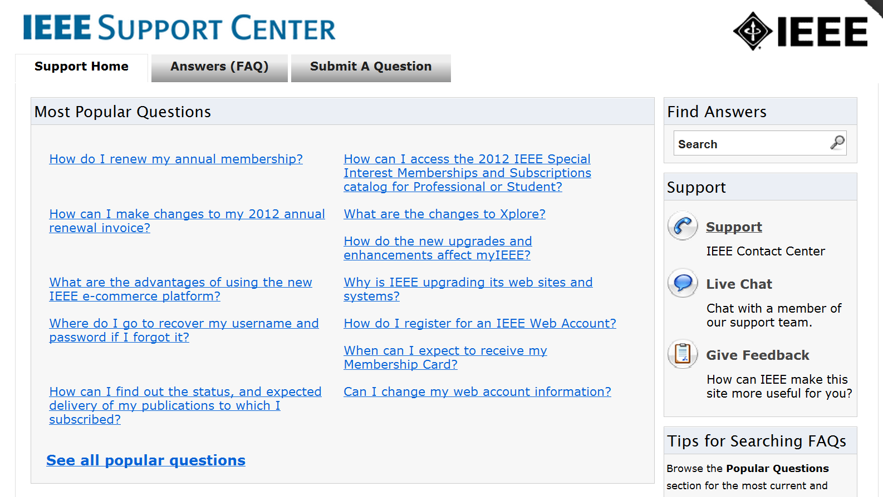

Slide 106
Some common acronyms 1
AIEE American Institute of Electrical Engineers
A&R Awards and Recognition
BoD Board of Directors
CLE Center for Leadership Excellence
EAB Educational Activities Board
ECC Electronic Communications Coordinator
EMEA Europe, Middle East, Africa (= Region 8)
EPICS Engineering Projects in Community Service
ExCom Executive Committee (in Section or Regions)
GSM Graduate Student Member

Slide 107
Some common acronyms 2
IBP IEEE Business Platform
ICP Interactive Content Project
ICX IEEE Conference Exchange
IEL IEEE/IET Electronic Library
IET Institution of Engineering and Technology
IRE Institute of Radio Engineers
MD Membership Development
MGA Member and Geographic Activities
N&A Nominations and Appointments
NIC New Initiative Committee
OpCom Operating Committee (in Region 8)
OU Organizational Unit

Slide 108
Some common acronyms 3
PA Professional Activities
POCO Panel of Conference Organizers
PSPB Publication Services and Products Board
RSR Region Student Representative
SA Standards Association
SAC Student Activities (sub)Committee
SBC Student Branch Congress
S/C Society/Council
SPC Strategic Planning Committee
SPC Student Paper Contest
SSR Section Student Representative

Slide 109
Some common acronyms 4
STEM Science, Technology, Engineering, Mathematics
STEP Student Transition and Elevation Partnership
TAB Technical Activities Board
TCS Technical Co-Sponsorship/ed
TISP Teacher In-Service Program
VCF Voluntary Contribution Fund
VC Vice Chair
VP Vice President
WiE Women in Engineering
YP Young Professionals
All Society (AES … VT) and Council (BIO … TM) acronyms

Slide 110

You can make the difference in the world
IEEE can help you

Slide 111

Questions?
Thank you! aluque@ieee.org vincenzo.piuri@unimi.it salazar@tsc.uc3m.es

